Slide 2

Introduction to Data Visualization
Santiago Paiva

Slide 3
Presentation Overview
Introduction (4 min)
Part 1: D3 (8 min)
Part 2: HighCharts (8 min)
Part 3: Google Visualizations (10 min)
Part 4: Grafana (4 min)
Conclusion (1 min)
Q & A (10 min)
Slides: http://www.github.com/spaiva/confoo-2017

Slide 4
About Me
Currently @ Montreal Neurological Institute & Hospital (The Neuro)
Startups (Busbud, Frank + Oak, Sharethebus)
Research (Polytechnique, McGill, MIT)
Confoo
2014: http://www.github.com/spaiva/confoo-2014
2016: http://github.com/spaiva/confoo-2016

Slide 5
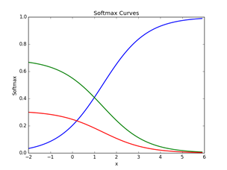
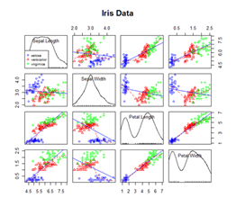
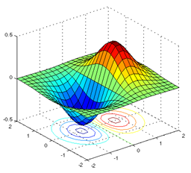
Python, R, and MATLAB
http://www.github.com/spaiva/deep-learning
http://www.statmethods.net/advgraphs/
http://www.matlab.izmiran.ru
Notes:
- https://www.buzzfeed.com/peteraldhous/spies-in-the-skies?utm_term=.lb56D7eDk#.ov6XdDedV

Slide 6
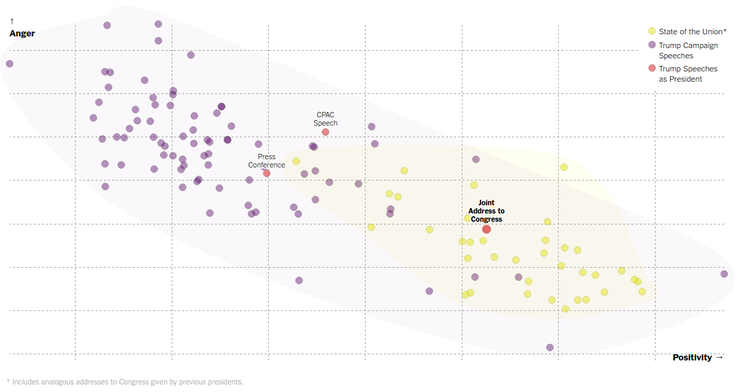
Trump Sounds a Different Tone in First Address to Congress
Mr. Trump’s address to Congress was closer in tone to a typical State of the Union address than it was to his previous public statements as president.
By JOSH KATZ and GREGOR AISCH FEB. 28, 2017, New York Times
Notes:
https://www.nytimes.com/interactive/2017/02/28/upshot/trump-sounds-different-tone-in-first-address-to-congress.html

Slide 7
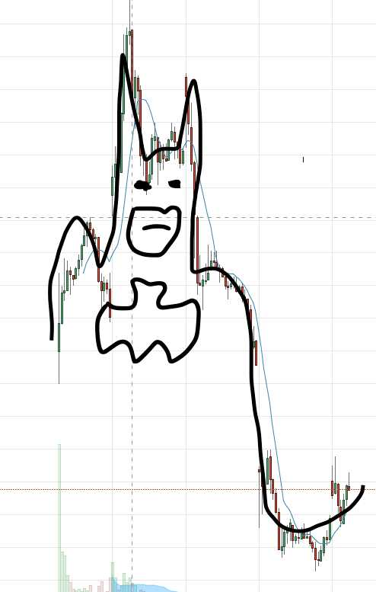
Snap Inc. (SNAP)
https://twitter.com/StockTwits/status/839591749274128384/photo/1
Notes:
https://www.buzzfeed.com/peteraldhous/spies-in-the-skies?utm_term=.lb56D7eDk#.ov6XdDedV

Slide 8
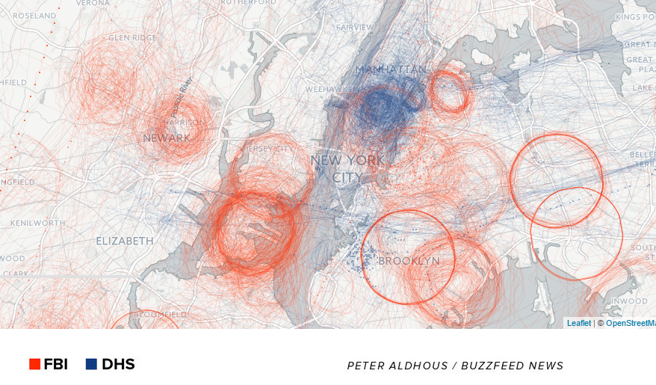
“Spies in the Skies”
https://www.buzzfeed.com/peteraldhous/spies-in-the-skies

Slide 9
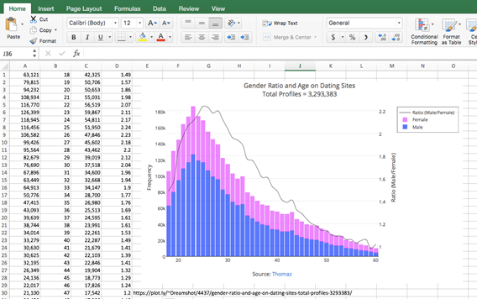
Excel Still Important
http://help.plot.ly/excel/graph-with-multiple-axes/

Slide 10
Part I: D3

Slide 11
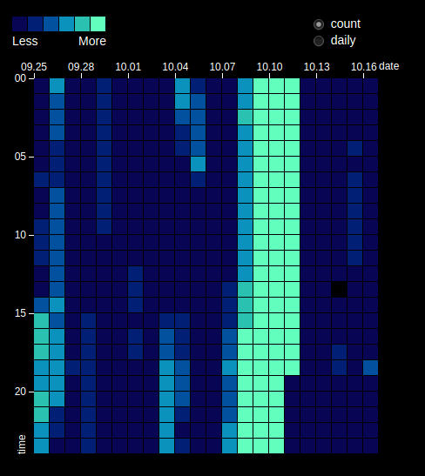
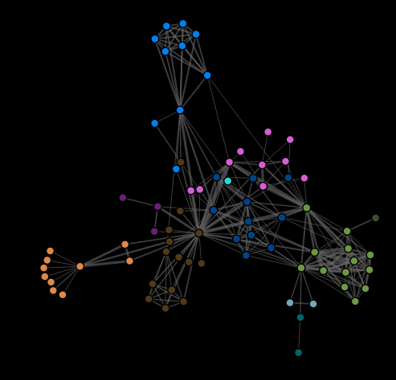
Data-Driven Documents (D3)
Examples: https://github.com/d3/d3/wiki/Gallery
Heat Maps
Dynamic Networks

Slide 12
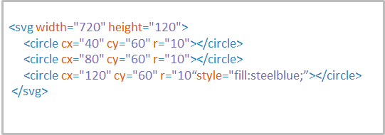
D3 - https://d3js.org
- Great Resources from Mike Bostock: https://bost.ocks.org
- Let’s start with a simple example: Three Little dots...
http://fiddle.jshell.net/F6YaR/1/

Slide 13
Advanced D3
Steep learning curve
Requires more complex js functions
JSON Data

Slide 14
Part II: HighCharts

Slide 15
HighCharts - http://www.highcharts.com/
https://twitter.com/Highcharts/status/839791587794251776

Slide 16
HighCharts
Example: Simple line graphs: https://jsfiddle.net/kg1hph6y/
https://twitter.com/Highcharts/status/839776784262520833

Slide 17
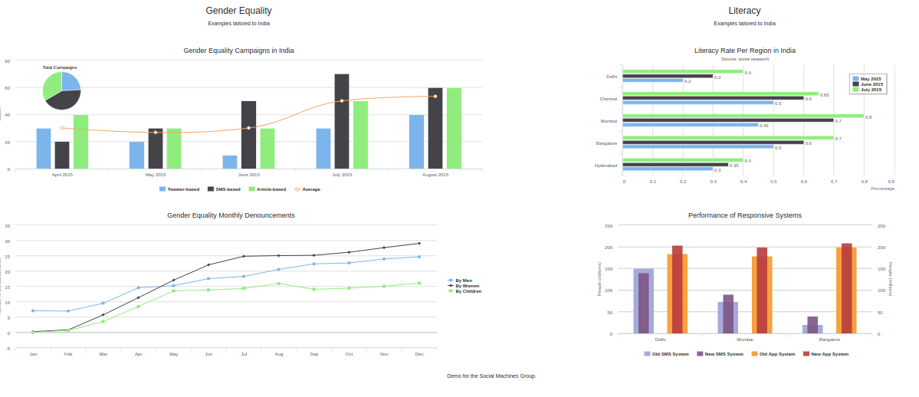
HighCharts
Great for building Analytics Dashboards with a web framework (like Flask)!
https://socialmachines.herokuapp.com/

Slide 18
Part III: Google Visualization

Slide 19
Google Visualizations
Documentation: https://developers.google.com/chart/interactive/docs/reference
Task: We want to visualize Confoo servers worldwide
Solution: LAMP setup + Google Visualization library
http://localhost/confoo

Slide 20
Google Visualization + React
Optimizing the graph rendering with React
http://localhost/confoo/index2.html

Slide 21
Part IV: Grafana

Slide 22
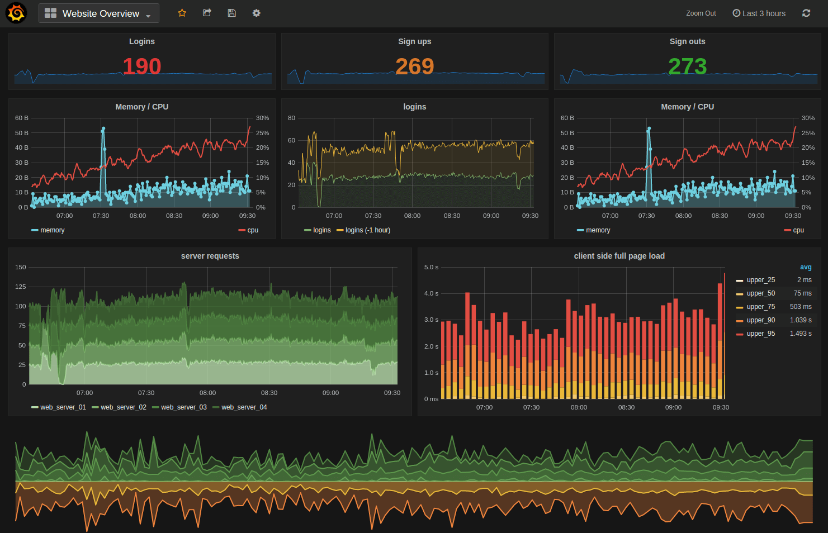
Grafana - http://grafana.org/
http://play.grafana.org/dashboard/db/grafana-play-home

Slide 23
Q & A
Introduction to Data Visualization
Santiago Paiva
paiva.santiago@gmail.com
@stronnics
github.com/spaiva/confoo-2017

